Slide 1

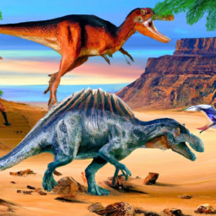
the era of dinosaurs
1. Dinosaurs lived during the Mesozoic Era, which lasted from about 252 million years ago to 66 million years ago. This era is divided into three periods: the Triassic, Jurassic, and Cretaceous.
2. Dinosaurs were not the only creatures that lived during the Mesozoic Era. Other animals, such as pterosaurs, marine reptiles, and early mammals, also thrived during this time.
3. The end of the Mesozoic Era is marked by a mass extinction event, which wiped out the dinosaurs and many other species. The cause of this extinction is still debated, but it is believed to have been caused by a combination of factors, including volcanic activity, climate change, and an asteroid impact.

Slide 2

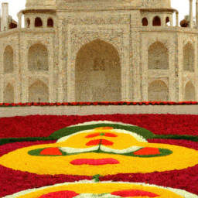

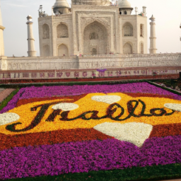
taj mahal
1. History and Architecture: Taj Mahal is a magnificent mausoleum located in Agra, India. It was built by Mughal Emperor Shah Jahan in memory of his beloved wife Mumtaz Mahal. The construction of Taj Mahal began in 1632 and took 22 years to complete. The architecture of Taj Mahal is a blend of Persian, Indian, and Islamic styles. The white marble structure is adorned with intricate carvings, calligraphy, and precious stones.
2. Symbolism and Significance: Taj Mahal is not just a beautiful monument, but it also holds great symbolic and cultural significance. It is considered a symbol of love, devotion, and eternal beauty. The intricate carvings and calligraphy on the walls of Taj Mahal depict verses from the Quran and other Islamic texts. The four minarets surrounding the main dome represent the four corners of the world, and the central dome symbolizes the heavens.
3. Tourism and Conservation: Taj Mahal is one of the most popular tourist destinations in India, attracting millions of visitors every year. However, the increasing footfall and pollution have taken a toll on the monument's pristine beauty. The Indian government has taken several measures to conserve and protect Taj Mahal, including limiting the number of visitors, banning plastic, and implementing strict pollution control measures. The conservation efforts have been successful in preserving the monument's beauty and ensuring its longevity for future generations.

Slide 3
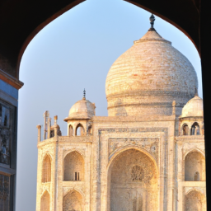
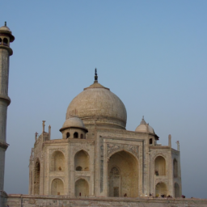
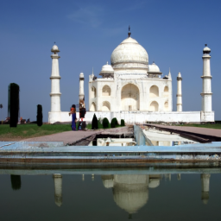
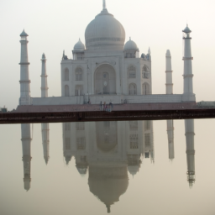
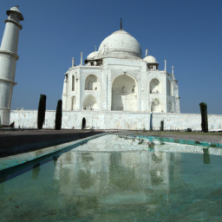
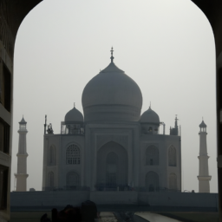
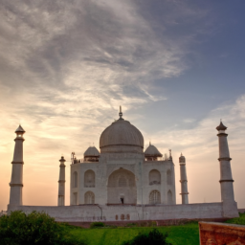
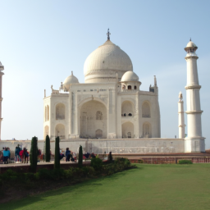
taj mahal
1. History and Architecture: Taj Mahal is a magnificent mausoleum located in Agra, India. It was built by Mughal Emperor Shah Jahan in memory of his beloved wife Mumtaz Mahal. The construction of Taj Mahal began in 1632 and took 22 years to complete. The architecture of Taj Mahal is a blend of Persian, Indian, and Islamic styles. The white marble structure is adorned with intricate carvings, calligraphy, and precious stones.
2. Symbolism and Significance: Taj Mahal is not just a beautiful monument, but it also holds great symbolic and cultural significance. It is considered a symbol of love, devotion, and eternal beauty. The intricate carvings and calligraphy on the walls of Taj Mahal depict verses from the Quran and other Islamic texts. The four minarets surrounding the main dome represent the four corners of the world, and the central dome symbolizes the heavens.
3. Tourism and Conservation: Taj Mahal is one of the most popular tourist destinations in India, attracting millions of visitors every year. However, the increasing footfall and pollution have taken a toll on the monument's pristine beauty. The Indian government has taken several measures to conserve and protect Taj Mahal, including limiting the number of visitors, banning plastic, and implementing strict pollution control measures. The conservation efforts have been successful in preserving the monument's beauty and ensuring its longevity for future generations.
1. History and Architecture: Taj Mahal is a magnificent mausoleum located in Agra, India. It was built by Mughal Emperor Shah Jahan in memory of his beloved wife Mumtaz Mahal. The construction of Taj Mahal began in 1632 and took 22 years to complete. The architecture of Taj Mahal is a blend of Persian, Indian, and Islamic styles. The white marble structure is adorned with intricate carvings, calligraphy, and precious stones.
2. Symbolism and Significance: Taj Mahal is not just a beautiful monument, but it also holds great symbolic and cultural significance. It is considered a symbol of love, devotion, and eternal beauty. The intricate carvings and calligraphy on the walls of Taj Mahal depict verses from the Quran and other Islamic texts. The four minarets surrounding the main dome represent the four corners of the world, and the central dome symbolizes the heavens.
3. Tourism and Conservation: Taj Mahal is one of the most popular tourist destinations in India, attracting millions of visitors every year. However, the increasing footfall and pollution have taken a toll on the monument's pristine beauty. The Indian government has taken several measures to conserve and protect Taj Mahal, including limiting the number of visitors, banning plastic, and implementing strict pollution control measures. The conservation efforts have been successful in preserving the monument's beauty and ensuring its longevity for future generations.

Slide 4
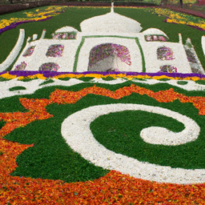
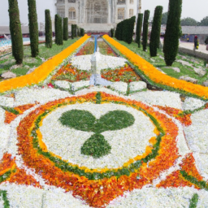
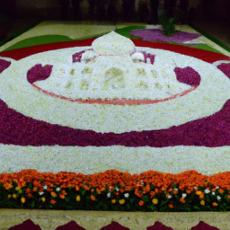
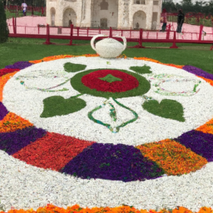
taj mahal
1. History and Architecture: Taj Mahal is a magnificent mausoleum located in Agra, India. It was built by Mughal Emperor Shah Jahan in memory of his beloved wife Mumtaz Mahal. The construction of Taj Mahal began in 1632 and took 22 years to complete. The architecture of Taj Mahal is a blend of Persian, Indian, and Islamic styles. The white marble structure is adorned with intricate carvings, calligraphy, and precious stones.
2. Symbolism and Significance: Taj Mahal is not just a beautiful monument, but it also holds great symbolic and cultural significance. It is considered a symbol of love, devotion, and eternal beauty. The intricate carvings and calligraphy on the walls of Taj Mahal depict verses from the Quran and other Islamic texts. The four minarets surrounding the main dome represent the four corners of the world, and the central dome symbolizes the heavens.
3. Tourism and Conservation: Taj Mahal is one of the most popular tourist destinations in India, attracting millions of visitors every year. However, the increasing footfall and pollution have taken a toll on the monument's pristine beauty. The Indian government has taken several measures to conserve and protect Taj Mahal, including limiting the number of visitors, banning plastic, and implementing strict pollution control measures. The conservation efforts have been successful in preserving the monument's beauty and ensuring its longevity for future generations.

Slide 5


jpmc
1. JPMorgan Chase & Co. is one of the largest financial institutions in the world, with a presence in over 100 countries. The company offers a wide range of financial services, including investment banking, commercial banking, asset management, and wealth management.
2. JPMorgan Chase has a strong commitment to corporate social responsibility, with a focus on sustainability, diversity and inclusion, and community engagement. The company has set ambitious goals to reduce its carbon footprint, increase diversity in its workforce, and support local communities through philanthropy and volunteerism.
3. JPMorgan Chase has a track record of innovation and technological advancement, with a focus on digital transformation and fintech partnerships. The company has invested heavily in developing new technologies and platforms to improve customer experience and streamline operations, and has formed strategic partnerships with leading fintech companies to stay at the forefront of industry trends.

Slide 6




butterflies
1. Life cycle: Butterflies undergo a complete metamorphosis, starting as an egg, then a caterpillar, pupa, and finally emerging as a beautiful butterfly. This process can take anywhere from a few weeks to several months, depending on the species.
2. Importance in ecosystems: Butterflies play a crucial role in pollination, helping to fertilize plants and ensure their survival. They also serve as a food source for other animals, such as birds and small mammals.
3. Threats to butterfly populations: Unfortunately, many butterfly species are facing threats such as habitat loss, climate change, and pesticide use. Conservation efforts are needed to protect these beautiful creatures and ensure their survival for future generations.

Slide 7
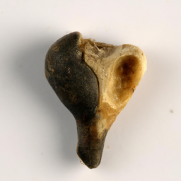
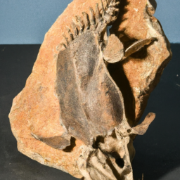
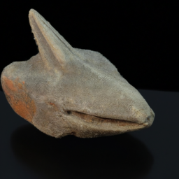
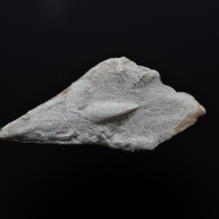
fossils
1. Fossils are the preserved remains or traces of ancient organisms that provide valuable insights into the history of life on Earth. They can include bones, shells, teeth, imprints, or even preserved soft tissues.
2. Fossils are formed through a process called fossilization, which involves the burial and gradual replacement of organic material by minerals. This process can take millions of years and requires specific conditions, such as sedimentation and the absence of oxygen.
3. Fossils are crucial for understanding evolutionary processes, as they provide evidence of extinct species and transitional forms. By studying fossils, scientists can reconstruct past ecosystems, track the development of different species, and uncover important clues about the Earth's geological history.

Slide 8
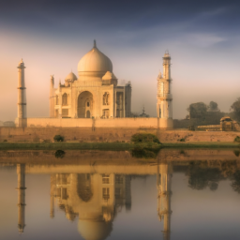

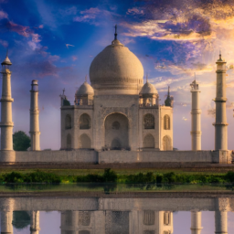
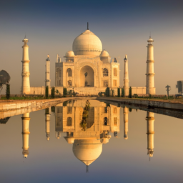
taj mahal
1. Architectural masterpiece: The Taj Mahal is a stunning example of Mughal architecture, renowned for its symmetrical design, intricate marble inlay work, and exquisite craftsmanship. Its iconic white marble dome and minarets make it a globally recognized symbol of love and beauty.
2. Symbol of eternal love: Built by Emperor Shah Jahan in memory of his beloved wife Mumtaz Mahal, the Taj Mahal is a testament to their eternal love. The mausoleum's romantic history and the story behind its construction add to its allure, making it a popular destination for couples and a symbol of everlasting love.
3. UNESCO World Heritage Site: Recognized as a UNESCO World Heritage Site in 1983, the Taj Mahal is considered a cultural and architectural treasure. Its preservation and conservation efforts ensure that future generations can appreciate and admire this magnificent monument, contributing to its global significance.

Slide 9
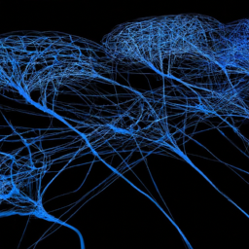
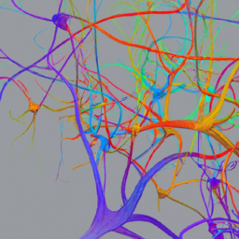
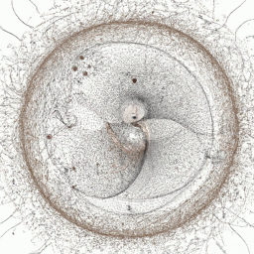
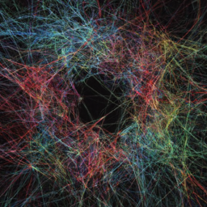
neural networks
1. Neural networks are a powerful tool for solving complex problems in various fields such as image and speech recognition, natural language processing, and predictive analytics. They are capable of learning from large amounts of data and extracting meaningful patterns, making them highly effective in tasks that require pattern recognition and decision-making.
2. Neural networks consist of interconnected layers of artificial neurons that mimic the structure and functioning of the human brain. This allows them to process and analyze data in a parallel and distributed manner, enabling faster and more efficient computations compared to traditional algorithms.
3. One of the key advantages of neural networks is their ability to learn and improve over time through a process called training. By adjusting the weights and biases of the network based on feedback from labeled data, neural networks can continuously refine their predictions and make increasingly accurate decisions, making them highly adaptable and suitable for dynamic environments.

Slide 10
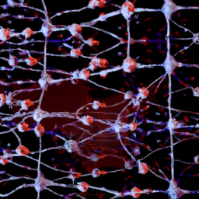
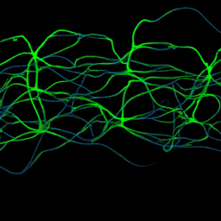
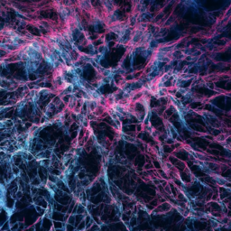
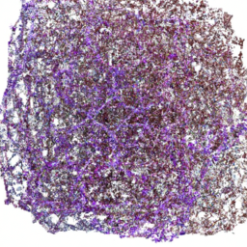
neural network
1. Neural networks are a powerful tool for solving complex problems in various fields such as image recognition, natural language processing, and financial forecasting. They are capable of learning from large amounts of data and making accurate predictions or classifications.
2. One of the key advantages of neural networks is their ability to automatically extract relevant features from raw data, eliminating the need for manual feature engineering. This makes them highly adaptable and suitable for tasks where the underlying patterns are not well understood or difficult to define.
3. Neural networks can be trained using a variety of algorithms, including backpropagation, convolutional neural networks (CNNs), and recurrent neural networks (RNNs). Each algorithm has its own strengths and is tailored to specific types of problems, allowing for flexibility and customization in designing neural network architectures.

Slide 11
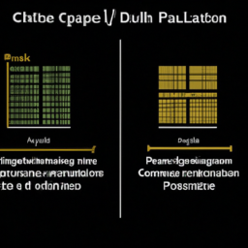
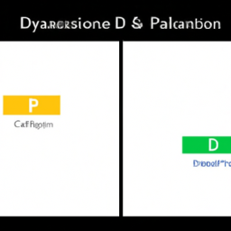
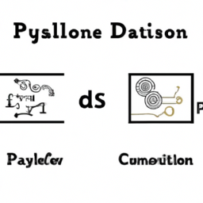
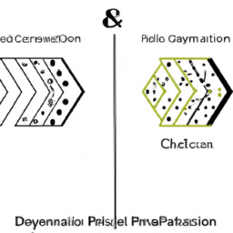
1. Performance: One key point to highlight is the difference in performance between C++ and Python. C++ is a compiled language, which means it is generally faster and more efficient than Python, which is an interpreted language. This makes C++ a preferred choice for applications that require high performance, such as game development or complex scientific simulations.
2. Syntax and Ease of Use: Another important aspect to discuss is the difference in syntax and ease of use between C++ and Python. C++ has a more complex syntax and requires explicit memory management, making it more challenging for beginners to learn and use effectively. On the other hand, Python has a simpler and more intuitive syntax, with automatic memory management, making it easier to write and read code. This makes Python a popular choice for beginners and rapid prototyping.
3. Ecosystem and Libraries: Lastly, it is worth mentioning the difference in the ecosystems and available libraries for C++ and Python. C++ has a vast collection of libraries and frameworks for various domains, such as Boost for general-purpose programming, OpenCV for computer vision, or TensorFlow for machine learning. Python also has a rich ecosystem with numerous libraries and frameworks, including NumPy, Pandas, and Django, which are widely used in data analysis, scientific computing, and web development. However, Python's ecosystem is generally considered more extensive and beginner-friendly, with a larger community and more readily available resources.
c++ vs python

Slide 12
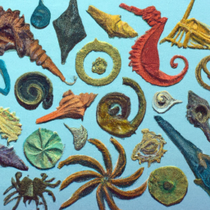
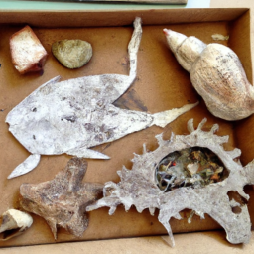
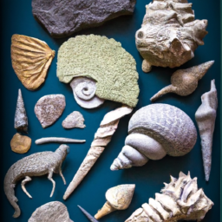
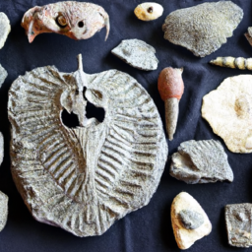
fossils
1. Fossils provide valuable insights into the history of life on Earth. By studying fossils, scientists can reconstruct the evolution of various species, understand their adaptations, and trace the development of ecosystems over millions of years. Fossils also help in determining the age of rocks and the timing of major geological events, providing a timeline for Earth's history.
2. Fossils are not limited to dinosaurs and ancient creatures. While dinosaurs are often the most popular fossils, there is a wide variety of other organisms preserved in the fossil record. Fossils can include plants, insects, marine organisms, and even microscopic organisms like bacteria. By studying these diverse fossils, scientists gain a comprehensive understanding of the past biodiversity and the interconnections between different species.
3. Fossils can reveal extraordinary details about ancient environments and climate. By examining the fossilized remains of plants and animals, scientists can infer the type of vegetation, temperature, and precipitation patterns that existed in the past. For example, the presence of certain plant fossils in a particular region can indicate the presence of a tropical rainforest millions of years ago. By understanding past climates, scientists can better predict and understand future climate change.

Slide 13
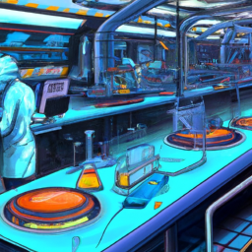
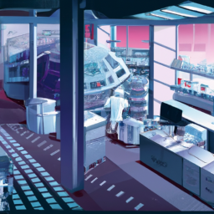
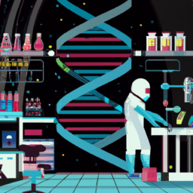

immunity
1. Immunity is the body's ability to defend itself against harmful pathogens, such as bacteria and viruses, and prevent them from causing illness or disease.
2. The immune system is composed of various cells, tissues, and organs that work together to identify and eliminate foreign substances in the body. This includes white blood cells, antibodies, and lymphatic vessels.
3. Immunity can be acquired through natural means, such as exposure to a pathogen and subsequent recovery, or through vaccination, which stimulates the immune system to produce a response without causing illness.

Slide 14


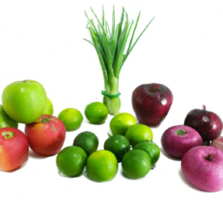
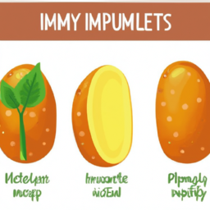
how to improve immunity?
1. Eat a balanced and nutritious diet: Consuming a variety of fruits, vegetables, whole grains, lean proteins, and healthy fats provides essential vitamins, minerals, and antioxidants that support a strong immune system.
2. Get regular exercise: Engaging in moderate-intensity physical activity for at least 150 minutes per week can enhance immune function. Exercise helps to increase blood circulation, reduce stress, and promote the production of immune cells.
3. Prioritize quality sleep: Aim for 7-9 hours of uninterrupted sleep each night. Sufficient sleep is crucial for immune system functioning, as it allows the body to repair and regenerate cells, and helps regulate immune responses.

Slide 15


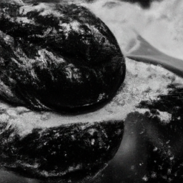
solids vs liquids
1. Solids have a fixed shape and volume, while liquids take the shape of their container and have a definite volume.
2. Solids have strong intermolecular forces, resulting in a rigid structure, whereas liquids have weaker forces, allowing them to flow and take the shape of their container.
3. Solids have a higher density compared to liquids, as their particles are closely packed together, while liquid particles are more spread out.

Slide 16
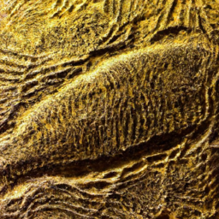
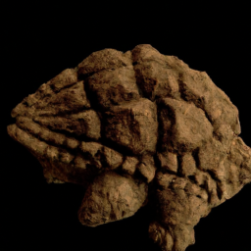
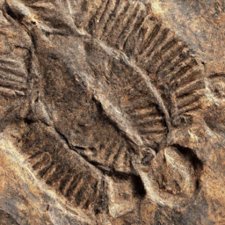

Fossils
1. Fossils provide valuable evidence of past life forms and help scientists understand the history of our planet. They can reveal information about the evolution of species, ancient ecosystems, and even climate change.
2. Fossils can be used to date rocks and determine the age of geological formations. By analyzing the fossils found in different layers of sedimentary rock, scientists can establish a relative timeline of events and understand the sequence of life on Earth.
3. Fossils have practical applications in various fields, such as paleontology, archaeology, and even medicine. They can help identify new species, study ancient human civilizations, and provide insights into the development of diseases and medical conditions.

Slide 17



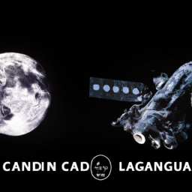
chandrayan 3
1. Chandrayaan 3 is India's third lunar exploration mission, aimed at furthering our understanding of the moon's surface and its composition. It will involve a lander and rover, similar to its predecessor Chandrayaan 2, but with improved technology and capabilities.
2. The primary objective of Chandrayaan 3 is to conduct detailed studies of the moon's south polar region, which remains largely unexplored. This region is of particular interest as it is believed to contain water ice, which could potentially support future human missions and serve as a valuable resource.
3. Chandrayaan 3 will also focus on enhancing India's technological capabilities in space exploration. It will incorporate lessons learned from the previous missions, addressing the challenges faced during Chandrayaan 2's landing attempt. This mission will further strengthen India's position in the global space community and pave the way for future ambitious space endeavors.

Slide 18
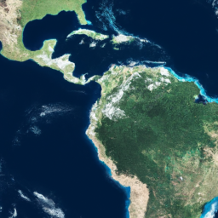
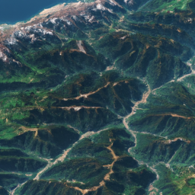


earth
1. Earth is the third planet from the Sun and the only known celestial body to support life. It has a unique combination of factors, including its distance from the Sun, presence of water, and a protective atmosphere, making it an ideal habitat for diverse forms of life.
2. Earth's geological features, such as mountains, oceans, and continents, provide a rich and varied environment for ecosystems to thrive. These features also play a crucial role in regulating the planet's climate, water cycle, and nutrient cycles, ensuring the sustainability of life on Earth.
3. Human activities, such as deforestation, pollution, and climate change, pose significant threats to the health and balance of Earth's ecosystems. It is essential for us to understand and address these challenges to protect the planet's biodiversity, maintain ecological balance, and secure a sustainable future for all living beings.

Slide 19




neural networks
1. Neural networks are a powerful tool for solving complex problems in various fields such as image and speech recognition, natural language processing, and predictive analytics. They are capable of learning from large amounts of data and extracting meaningful patterns, making them highly effective in tasks that require pattern recognition and decision-making.
2. Neural networks consist of interconnected layers of artificial neurons that mimic the structure and functioning of the human brain. This allows them to process and analyze data in a parallel and distributed manner, enabling faster and more efficient computations compared to traditional algorithms.
3. One of the key advantages of neural networks is their ability to learn and improve over time through a process called training. By adjusting the weights and biases of the network based on feedback from labeled data, neural networks can continuously refine their predictions and make increasingly accurate decisions, making them highly adaptable and suitable for dynamic environments.

Slide 20




robot
1. Efficiency: Robots can perform repetitive tasks with high precision and speed, leading to increased productivity and reduced human error. This can significantly improve efficiency in industries such as manufacturing, logistics, and healthcare.
2. Safety: Robots can be deployed in hazardous environments or perform dangerous tasks that may pose risks to human workers. By replacing humans in these situations, robots can help prevent accidents and injuries, ensuring a safer work environment.
3. Innovation: The advancements in robotics technology have led to the development of intelligent robots capable of learning and adapting to new situations. These robots can contribute to innovation by automating complex processes, enabling businesses to explore new possibilities and improve their products or services.

